Slide 1
Predictive Insights for Banking Customer Churn

Slide 2
Contents
Introduction
Problem Statement
Methodology
Demo
Results
Discussion
Future Work
Conclusion

Slide 3
Introduction
What is customer churn?
Why studying customer churn in bank is important?
What are our aims?
Aim is to predict churning customers in bank.
How will we solve banking customer churn problem?
Using ML techniques and Tableau Visualizations
How will our predictions help?
It will help marketing team to target customers and retain them.

Slide 4
Problem Statement
Customer churn is a significant concern. It affects:
Revenue
Cost of Acquisition
Reputation
Market Standing

Slide 5
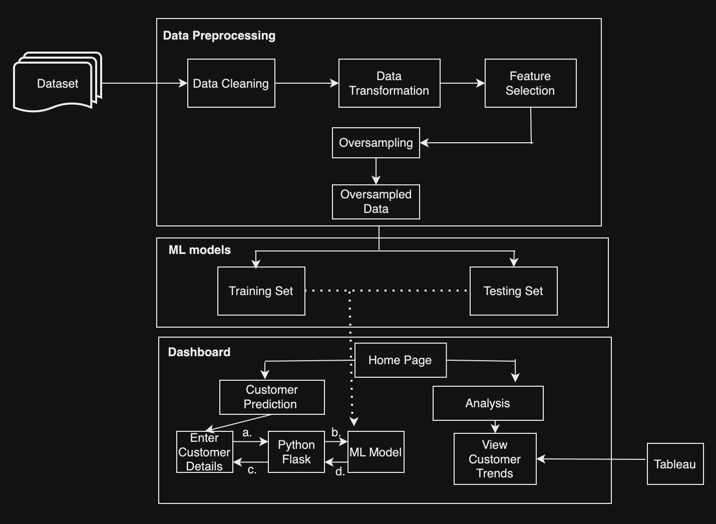
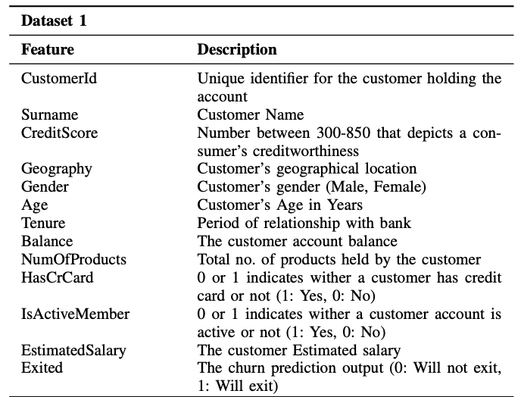
Methodology
Dataset: Churn Dataset from Kaggle.[1] Consists of 10,000 records & 13 features. ‘Exit’ is the target variable. Dataset loaded using ‘pandas’.
Fig 2: Dataset description [2]
Fig 1: Methodology

Slide 6
Methodology
Data Preprocessing:
Data Cleaning | Irrelevant features removed: (RowNumber, CustomerId, and Surname)
Data Transformation | Performing Data Encoding (Gender, Geography) and Feature Scaling using MinMaxScalar
Feature Engineering | Added balanceSalaryRatio, TenureGivenAge, CreditScoreGivenAge for EDA, removed in feature selection
Feature Selection | Important features selected
Oversampling | Why need of oversampling? Data balanced using SMOTE.
Fig 1: Methodology

Slide 7
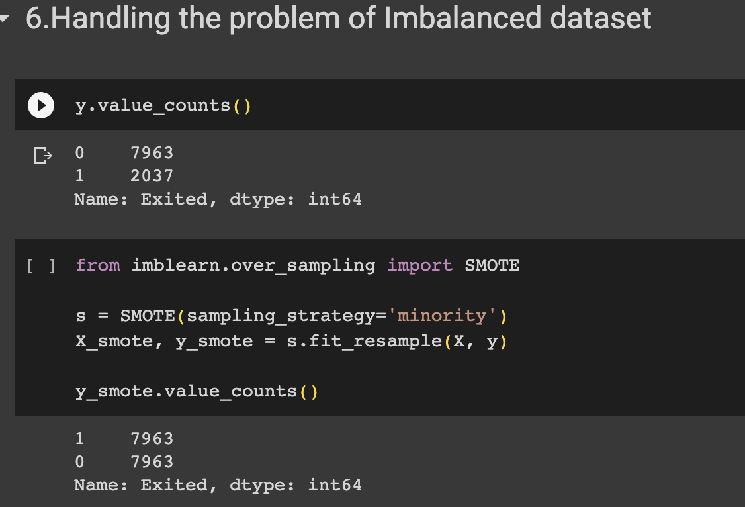
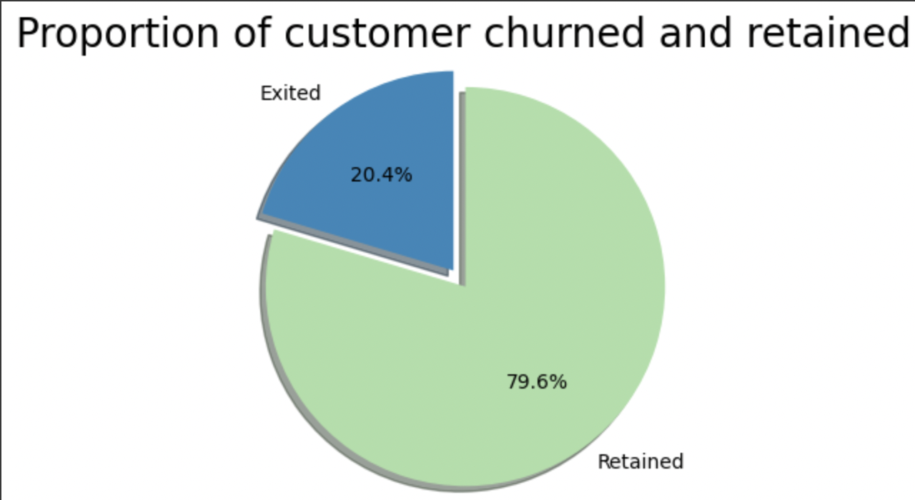
Methodology - Need of Oversampling
Because the data was imbalanced:
We are interested in data of ‘Exited’ rather than ‘Retained’
Exited data only 20.4%
We need to balance data
Used SMOTE technique to balance it
Fig: Before Data Balancing

Slide 8
Methodology
ML Models:
Data split: 70% for training, 30% for testing.
8 Machine Learning Algorithms used:
Logistic Regression
Logistic Regression with 2nd degree polynomial
SVM with Rbf and poly kernels
Random Forest Classifier
Extreme Gradient Boosting Classifier
Artificial Neural Network
8 models created and compared.
Best model chosen for dashboard: XGBoost.
XGBoost model exported as pickle file for dashboard use.
Fig 1: Methodology

Slide 9
Methodology
Dashboard:
Offers a user-friendly interface for interacting with the XGBoost model and viewing predictions.
User Interaction: Users input customer details via the dashboard.
Request Process: Dashboard triggers a request to Flask server's API for prediction.
Flask Server: Processes the request, loads XGBoost model from pickle file, applies it to input data.
Prediction Result: Flask server sends prediction outcome back to dashboard for display.
Additional Insights: Dashboard provides customer trends via Tableau integration on the website.
Fig 1: Methodology

Slide 10
Demo

Slide 11
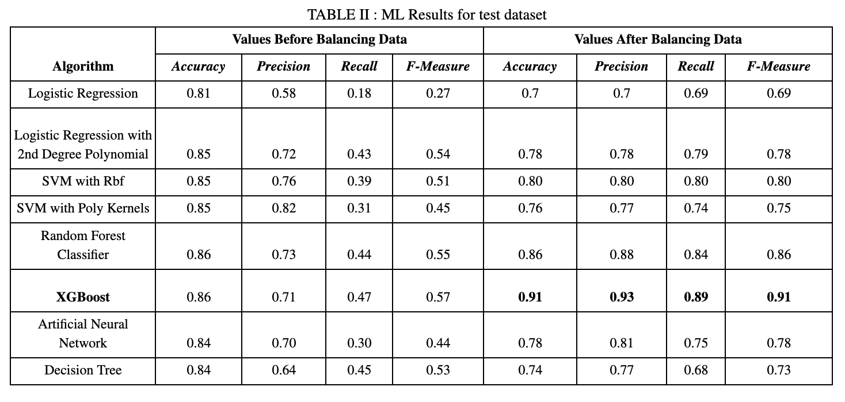
Results
Compared ML in terms of metrics before and after balancing data
Improved Performance after balancing: Precision, recall, f-measure
Accuracy declined
XGBoost best model

Slide 12
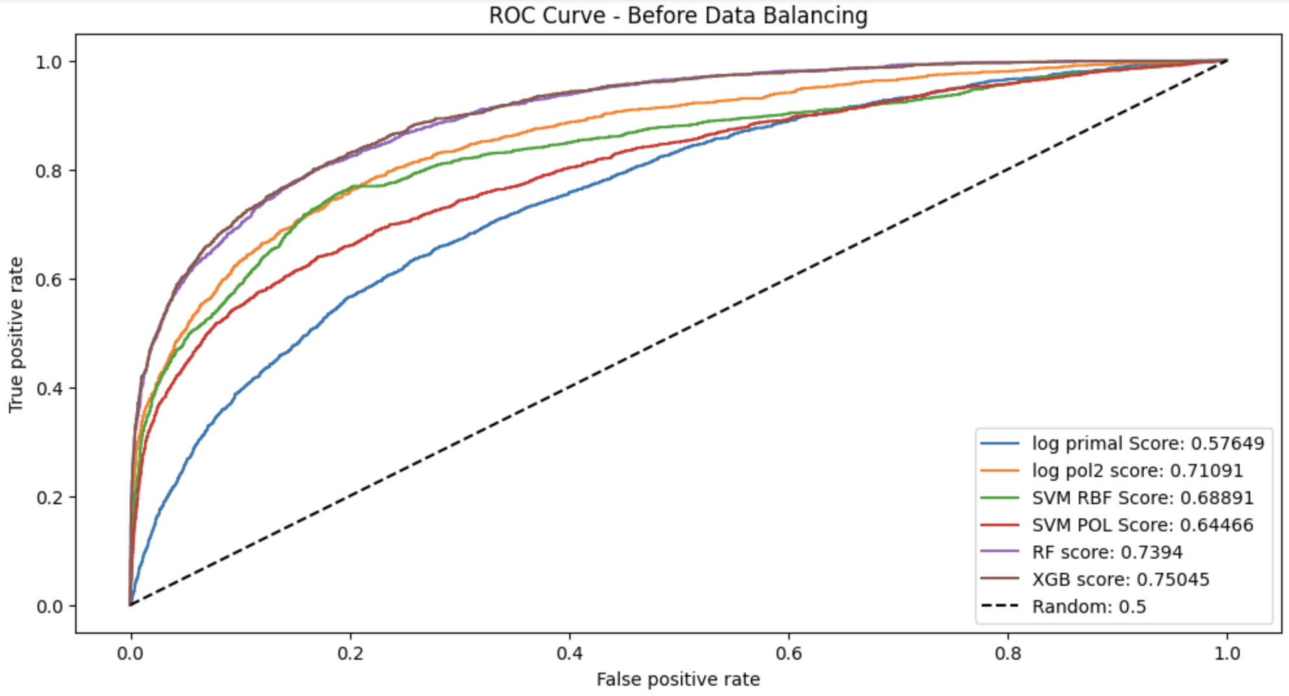
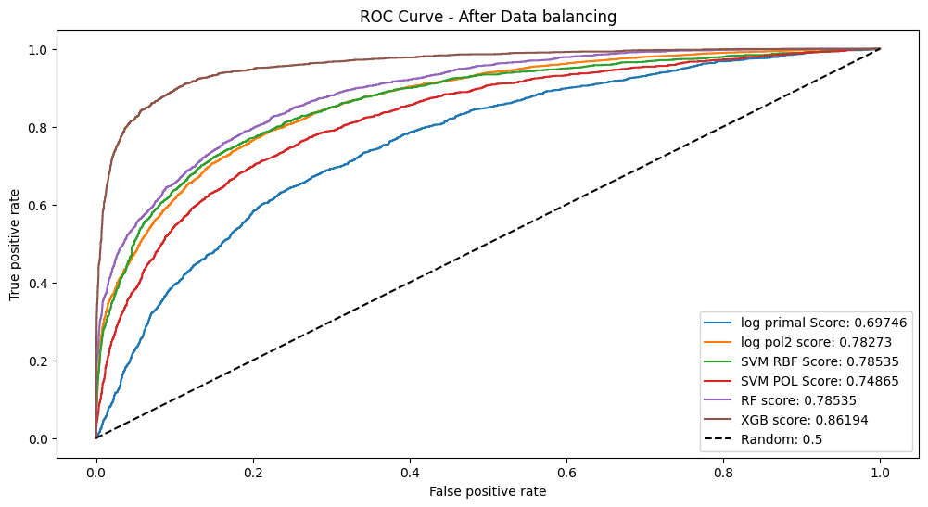
Results
ROC Curve - Before & After Data Balancing:
What is ROC Curve?
After data balancing: Improved Scores
XGBost: highest curve

Slide 13
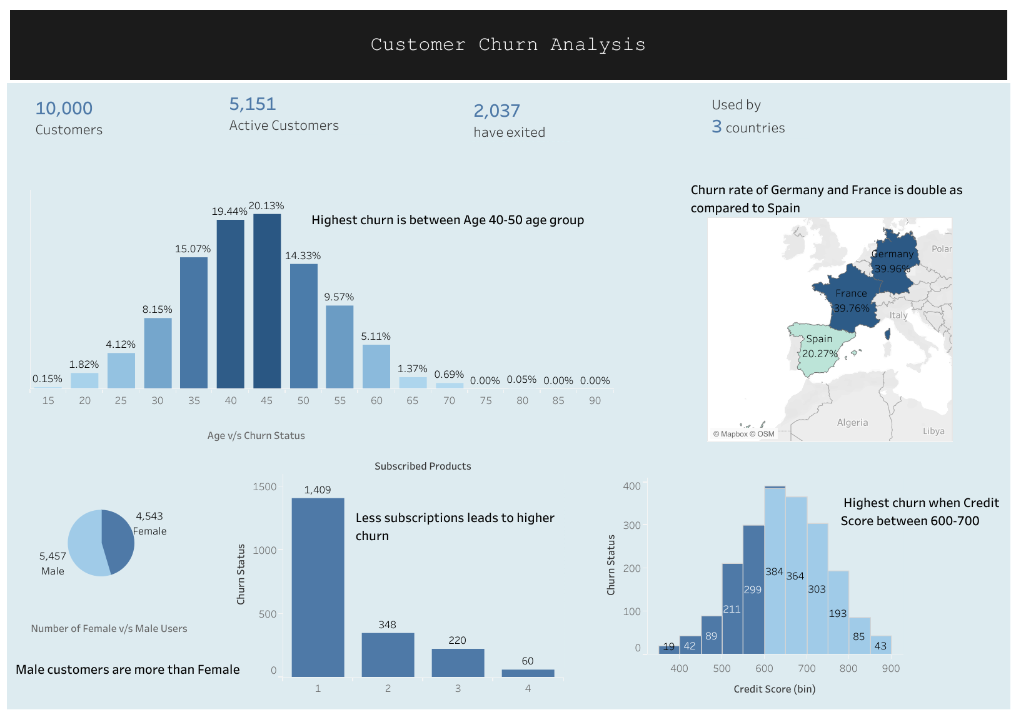
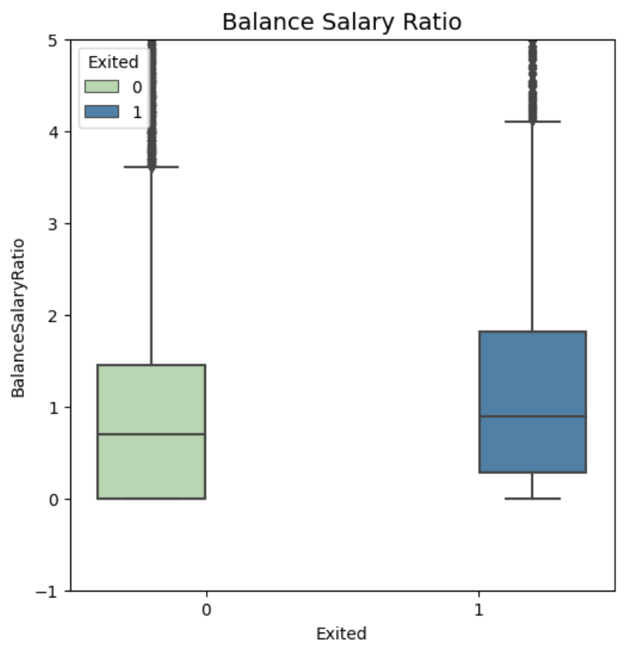
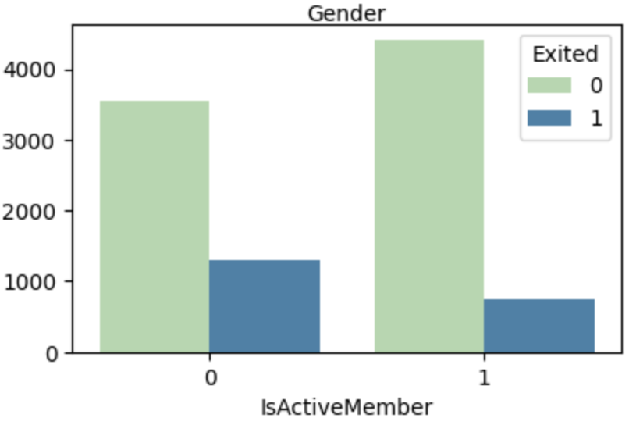
Discussion
Attention should be paid to:
Age 40-50 group
Credit Score between 600-700
Less number of subscribed products
Females
Germany customers followed by France
Inactive customers
High Balance Salary Ratio

Slide 14
Future Work
Future Work - Algorithm Expansion
Include advanced algorithms like Recurrent Neural Networks, LSTM, and Deep Learning Models
Future Work - Dashboard Enhancement:
Enhance the dashboard's flexibility and adaptability.
Make it suitable for diverse data and business scenarios.

Slide 15
Conclusion
Effective Solution:
Successfully addressed banking's customer churn using XGBoost and Tableau.
Impressive Results:
XGBoost achieved 96% accuracy on training and 91% on testing, with the highest ROC curve.
Dashboard Utilization:
Chose XGBoost for dashboard, combining predictive power with Tableau insights.
Future Enhancements:
Advanced algorithm, dashboard enhancement, cloud
Long-term Perspective:
Future focus on holistic customer retention strategies to ensure banking industry success and stability.

Slide 16
References
Adam (2018) Predicting churn for Bank customers, Kaggle. Available at: https://www.kaggle.com/datasets/adammaus/predicting-churn-for-bank-customers (Accessed: 23 August 2023).
Dalbah, L.M., Ali, S. and Al-Naymat, G. (2022) ‘An interactive dashboard for predicting bank customer attrition’, 2022 International Conference on Emerging Trends in Computing and Engineering Applications (ETCEA) [Preprint]. doi:10.1109/etcea57049.2022.10009818.

Slide 17
Thank you!!

